Slide 1

Handwriting Recognition Using Neural NetworkS
Using two approaches: Convolutional and Feed Forward Neural Networks
By:
Ashirbad Meher 1504017
Akshay Kumar Gupta 1504074
Aayush Malviya 1504076
Notes:
NOTE:
To change the image on this slide, select the picture and delete it. Then click the Pictures icon in the placeholder to insert your own image.

Slide 2
Why Handwriting Recognition ?
Our Minds are so good at recognizing images, that it may recognize image even at very low pixels. It is all attributed to our smart visual cortex, that has evolved over thousands of years and millions of neurons, that works at lightning speed to deliver image to our brain and recognizing it.
This project is inspired from this complex function of our brain, that does it so easily.
We have billions of images of document with text in it. But a computer cannot understand any of it. We are proposing two approaches for handwriting Recognition.
Both approaches uses neural network, but different types:
Convolutional Neural Network
Feed Forward Neural Network

Slide 3
What are Neural Networks and why use them ?
According to Wikipedia, Artificial neural networks (ANNs) are computing systems vaguely inspired by the biological neural networks that constitute animal brains.
They might learn to identify images that contain cats by analysing example images that have been manually labelled as "cat" or "no cat" and using the results to identify cats in other images.
They do this without any a prior knowledge about cats, e.g., that they have fur, tails, whiskers and cat-like faces. Instead, they evolve their own set of relevant characteristics from the learning material that they process.
A neural network, along with learning a model for classification is able to create and select automatically useful features, thus using these features they classify images.

Slide 4
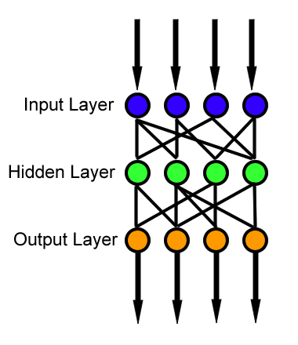
Approach One: Feed Forward Neural Networks
Feed Forward Neural Networks is artificial neural network wherein connection between units do not form cycle.
The feedforward neural network was the first and simplest type of artificial neural network devised. In this network, the information moves in only one direction, forward, from the input nodes, through the hidden nodes (if any) and to the output nodes.
Source: Wikipedia.org

Slide 5
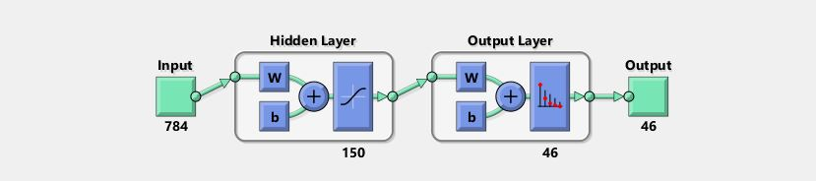
Architecture of Feed Forward Neural Networks
Input Node: 784
No. of Neurons in hidden layer: 150
Output Node: 46
Training Algorithm: Scaled Conjugated Gradient backpropagation
Performance Function: Cross Entropy
Image Source : MATLAB

Slide 6
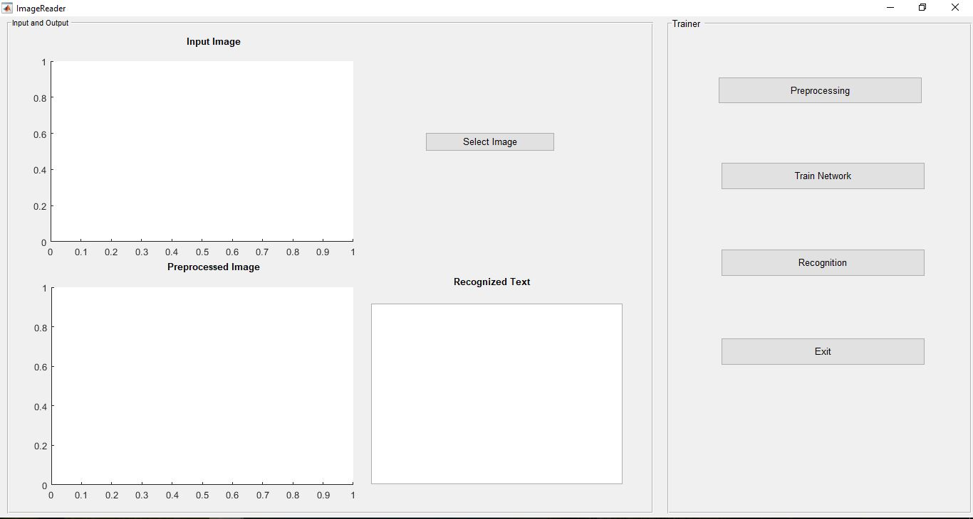
Implementation on MATLAB

Slide 7
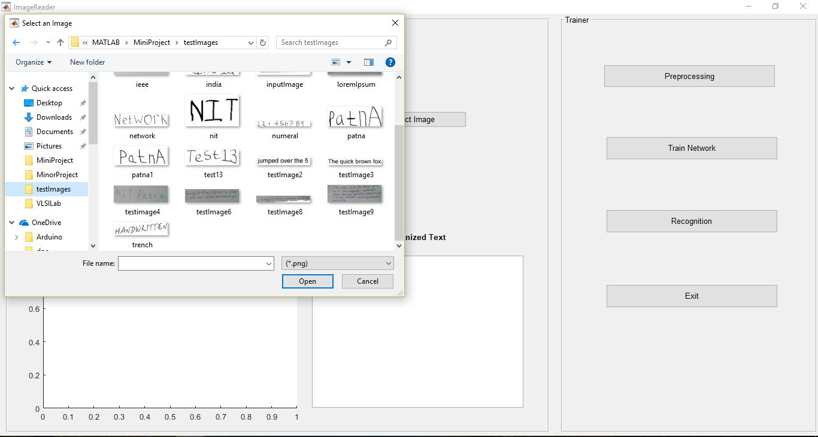

Slide 8
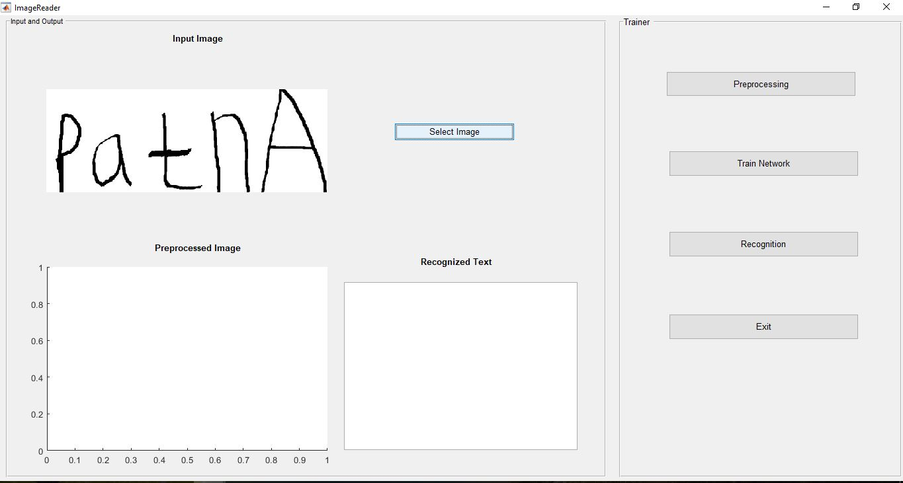

Slide 9
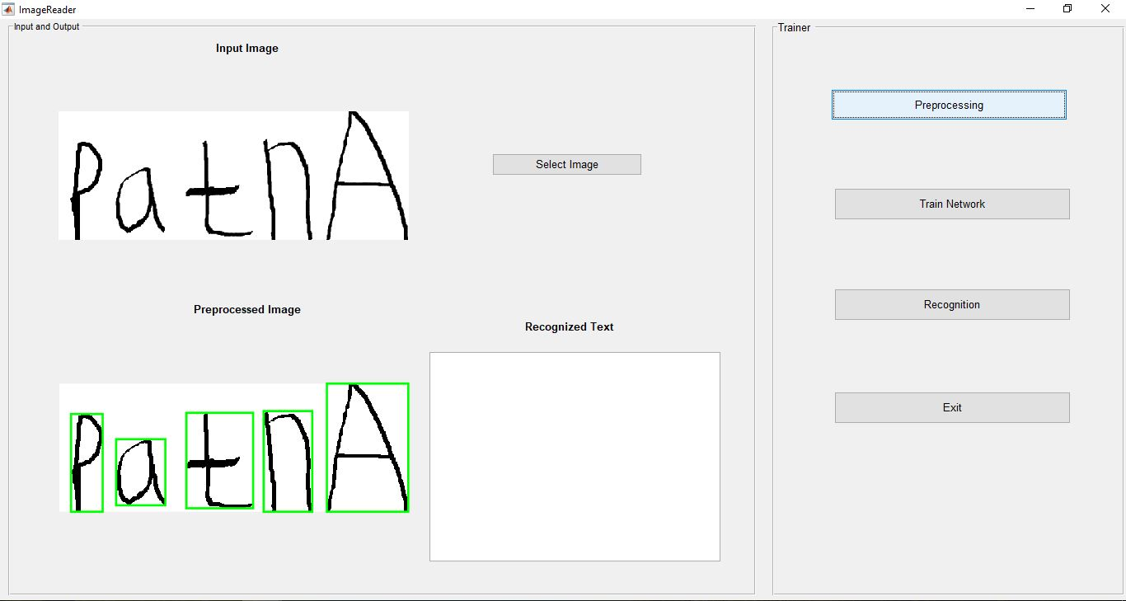

Slide 10
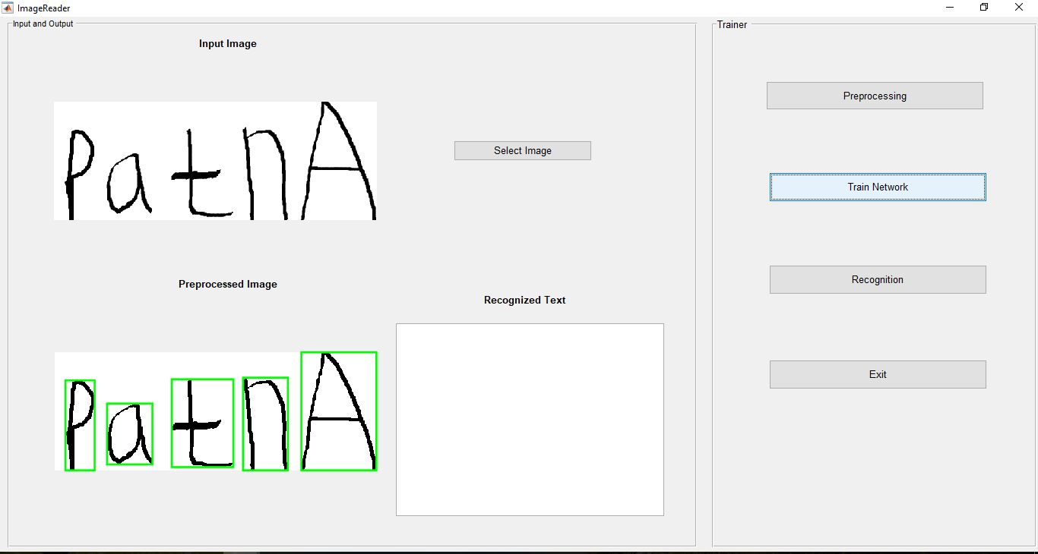

Slide 11
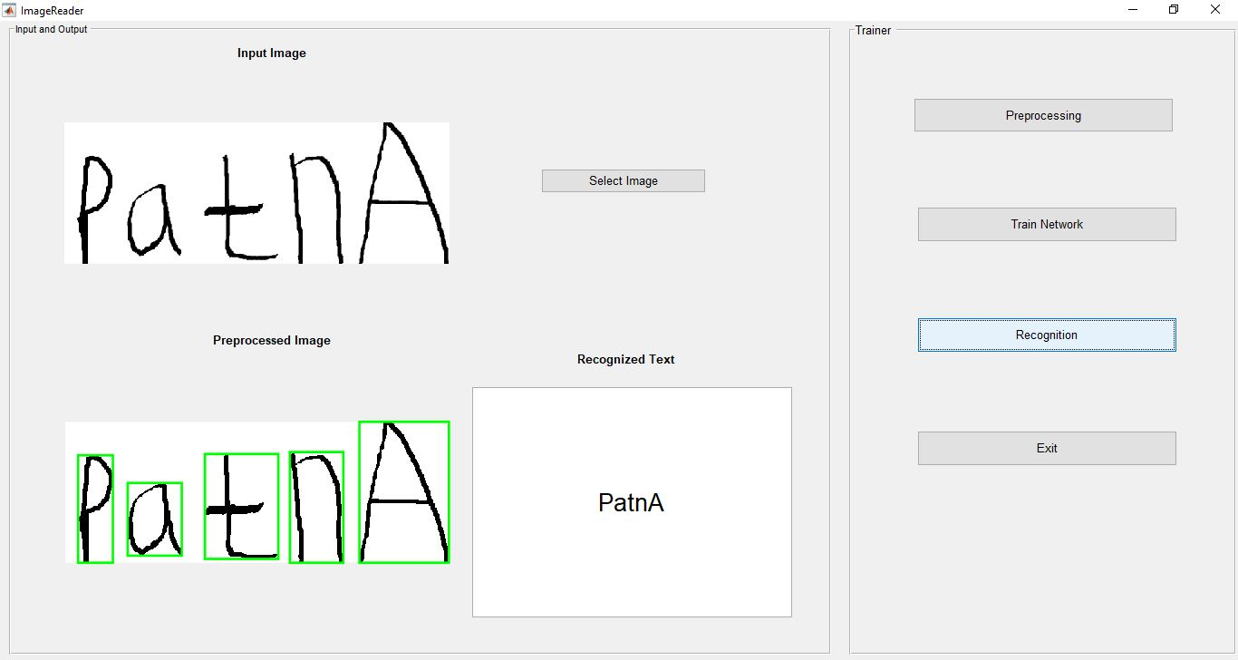

Slide 12
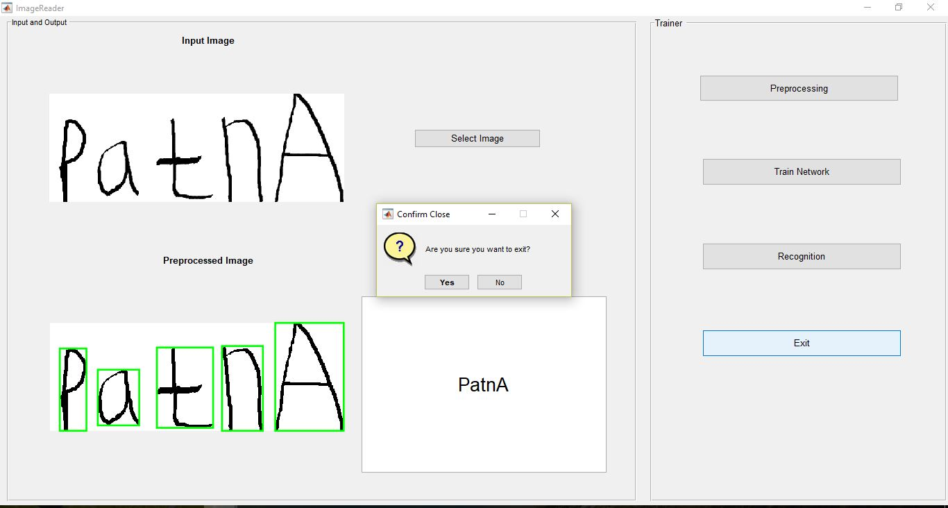

Slide 13
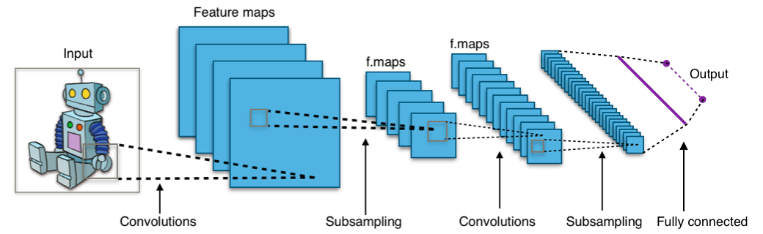
Approach two : Convolutional Neural Networks
CNNs are biologically-inspired models inspired by research by D. H. Hubel and T. N. Wiesel. They proposed an explanation for the way in which mammals visually perceive the world around them using a layered architecture of neurons in the brain
A CNN consists of an input and an output layer, as well as multiple hidden layers. The hidden layers of a CNN typically consist of convolutional layers, pooling layers, fully connected layers and normalization layers.
Image Source: Wikipedia.org

Slide 14
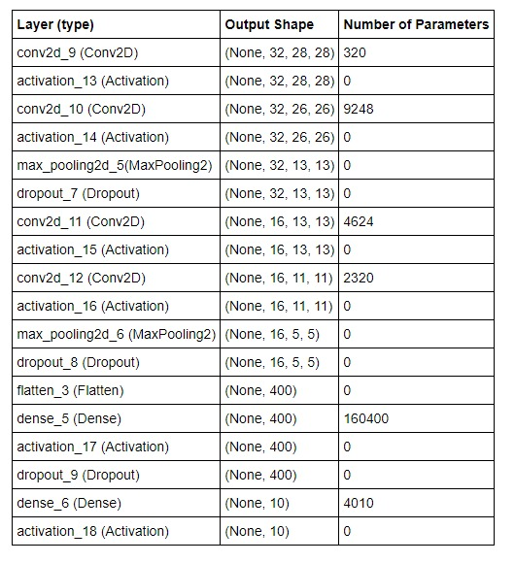
Architecture of CNN

Slide 15
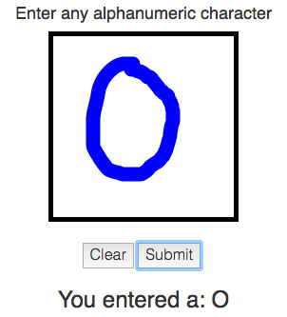
Implementation on Python

Slide 16
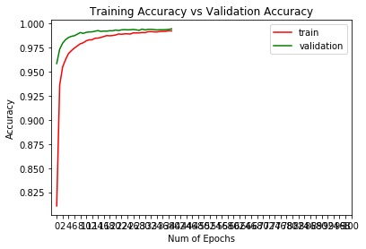
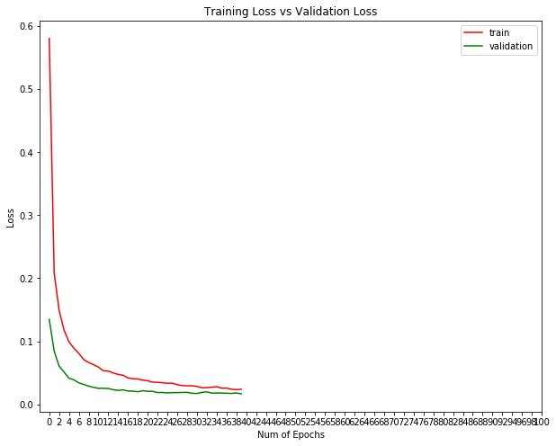
Experimental Results

Slide 17
Conclusion
A handwriting recognition system is successfully implemented using both CNNs and Feed Forward Neural Networks.
CNNs outperformed other approach with an accuracy of 99.45%.
While feed forward neural network has only accuracy of 81.2%.

